Slide 1
Module 5: Sampling
5.12: Advanced data collection
Annie Collins
Data Sciences Institute, University of Toronto

Slide 2
Learning Outcomes
What happens when things aren’t so simple?
Estimate appropriate sample size for a given study.
Identify use cases for sampling in multiple stages and the corresponding benefits and drawbacks.
Use the mice R package to implement multiple imputation.

Slide 3
Key Texts
Lohr, 2019, Sampling Design and Analysis, 2nd Edition, CRC Press.
Section 2.6
Section 8.3
Chapter 12
Stef van Buuren, Karin Groothuis-Oudshoorn (2011). mice: Multivariate Imputation by Chained Equations in R. Journal of Statistical Software, 45(3), 1-67. DOI 10.18637/jss.v045.i03.

Slide 4
Calculating Sample Sizes

Slide 5
Calculating Sample Size
Determine the desired precision for the quantities that will be estimated from the sample.
What are the consequences of the study results? How much error is tolerable?
Find an equation relating the sample size n and your desired precision from step 1.
Precision should be in terms of error or variation
Estimate unknown quantities in the equation and solve for n.

Slide 6
Determine desired precision
A common way to express precision is in terms of the margin of error, e, and confidence level, 1 - 𝜶.
This can be interpreted as desiring a sample size n such that there is a probability of (1 - 𝜶) that the absolute difference between the population and sample means is less than the specified error.
Common values for margin of error and confidence level are e = 0.03 and 𝜶 = 0.05 (95% confidence level).

Slide 7
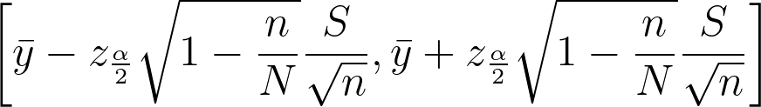
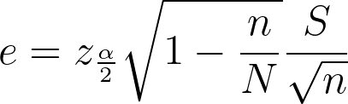
Find an equation relating precision and sample size
Observe the formula for a 100(1 - 𝛼)% confidence interval:
where z²_{𝛼/2} is the (1 - 𝛼/2)th percentile of the standard normal distribution, N is the population size, and S is the population standard deviation.
This gives us a logical formula for our specified e:

Slide 8
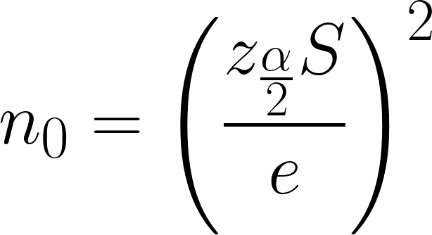
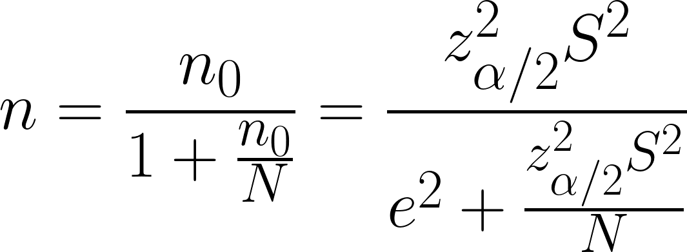
Find an equation relating precision and sample size
We first find n₀, the sample size that would be used for a simple random sample without replacement:
Then the desired n is:

Slide 9
3. Estimate unknown quantities
The values in our equation for n are z²_{𝛼/2}, S, e, and N.
𝛼 is chosen in step 1 and z²_{𝛼/2} can be calculated directly. For 𝛼 = 0.05, z²_{𝛼/2} = 1.96.
e is also chosen in step 1
N should be known
S must be estimated

Slide 10
3. Estimate unknown quantities
Strategies for estimating S
Run a pilot survey on a small sample and calculate S² based on this survey
Use previous studies or related data that already exists
Guess based on a hypothesized distribution
Once S is estimated and the other quantities are determined, the equation can be solved to determine the appropriate n

Slide 11
Considerations
Often the initial sample size calculated will be much larger than what is realistic
Consider whether or not the study is feasible given the available budget and desired precision
Adjust estimates or precision expectations accordingly
Larger sample = smaller sampling error, but a larger sample size may increase non-sampling errors
Sample size should not be based on proportion of population size
Precision is obtained through absolute sample size, not samples size relative to population size

Slide 12
Multiphase Sampling

Slide 13
Multiphase Sampling
Multiphase sampling involves collecting individuals to form a sample over the course of multiple distinct sampling procedures.
Potential use cases:
Variable of interest is difficult to measure/identify, but a related characteristic can be measured easily and used to improve data collection
Adjusting for non-reponse
Reaching rare/hidden populations (section 5.11 Respondent-driven sampling)
Generally improving sampling frame

Slide 14
Two-Phase Sampling to Improve Measurement
Consider a population of N observational units. A sample can be taken in the following phases:
Phase 1: Select a sample of n⁽¹⁾ units and measure variables x for each unit.
n⁽¹⁾ is generally relatively large, and variables x are generally inexpensive and/or easy to measure
Phase 2: Consider the sample from Phase 1 to be its own population. Select a sample of n⁽²⁾ units from this population and measure the variable(s) of interest for each unit.
Variables x measured in Phase 1 can be used to design the Phase 2 sampling procedure (i.e. stratifying, clustering, determining eligibility)

Slide 15
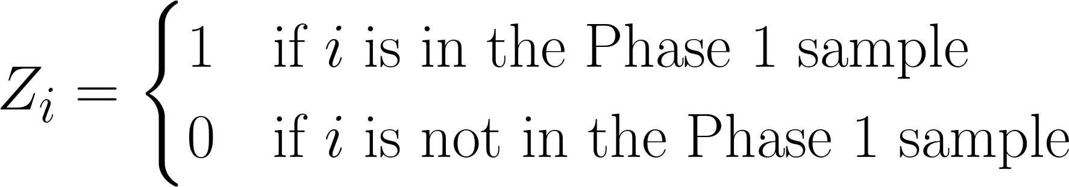
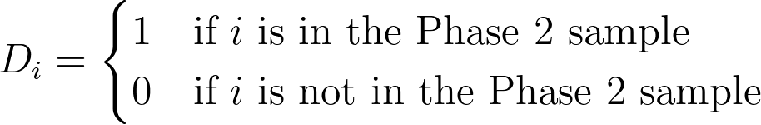
Two-Phase Sampling to Improve Measurement
The units selected in Phase 1 are determined by the random variable,
The units selected in Phase 2 are determined by the random variable,

Slide 16


Two-Phase Sampling to Improve Measurement
The inclusion probability for units in Phase 1 can be described as,
As usual, the weights for sampled units in Phase 1 are,

Slide 17

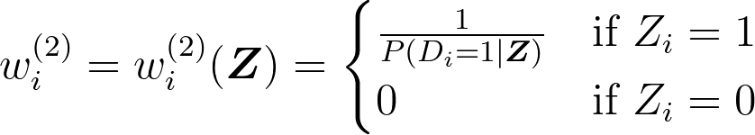
Two-Phase Sampling to Improve Measurement
The inclusion probability for units in Phase 2 is conditional upon their inclusion in Phase 1, i.e.
where Z is the vector (Z₁, Z₂,..., Z_{N}). The weights for units in Phase 2 is a function of Z as well:

Slide 18
Two-Phase Sampling for Nonresponse
Two-phase sampling is a sort of stratified sampling that attempts to produce estimates that account for nonresponse bias.
Steps:
Take an SRS of n units from the population of N units.
Within this sample, n_{R} units will respond and n_{M} units will not respond, with
n_{R} + n_{M} = n .
Resample some fraction of the n_{M} nonrespondents, with 𝝼 representing the sampling fraction.

Slide 19


Two-Phase Sampling for Nonresponse: Estimates
If all n_{M} nonrespondents respond in the second phase, we can use the following estimators for the population mean and total:
with and representing the sample means for the initial respondents and secondary respondents respectively.
Notes:
Emphasize that this only works if ALL units sampled in the second phase respond. Methods for covering remaining nonresponse begin on the next slide and employ model-based methodology.

Slide 20
Designing a Multi-Phase Sample
Is a multi-phase sample really more efficient than a single phase sample?
Could the same accuracy be obtained more cheaply or easily with a single phase sample?
How many resources should be allocated to each phase?
Some phases may be less expensive than others
How closely related are the data points collected at each stage?
If data collected in phase 1 does not assist with the sampling or data collection procedure in subsequent stages, the sampling and survey design may need reconsideration
How high is respondent burden?
Some respondents may need to be surveyed more than once; respondent burden should be minimized

Slide 21
Imputation with mice

Slide 22
Imputation (from 5.8 Nonresponse)
Imputation is the process of assigning values to missing items in a data set
Used to reduce nonresponse bias and produce cleaner data for analysis
Imputed values are often taken from other respondents with similar non-missing responses as the unit with the missing item
For this module, we will consider specifically multiple imputation

Slide 23
Multiple Imputation
Procedure
Impute missing data using a model that incorporates random variation.
Repeat step 1 multiple times to create multiple data sets with varying imputed values.
Perform analysis on each data set using standard methods.
Average parameter estimates across imputed data sets in order to produce one point estimate.
Calculate the standard errors by averaging standard square errors across imputed data set estimates
Source: https://www.statisticssolutions.com/dissertation-resources/multiple-imputation-for-missing-data/

Slide 24
mice R Package
MICE stands for Multivariate Imputations by Chained Equations
The mice R package documentation presents the following typical workflow:
Impute the missing data by the mice() function, resulting in a multiple imputed data set (class “mids”);
Fit the model of interest (scientific model) on each imputed data set by the with()function, resulting an object of class “mira”;
Pool the estimates from each model into a single set of estimates and standard errors, resulting in an object of class “mipo”;
Optionally, compare pooled estimates from different scientific models by the D1() or D3() functions.

Slide 25
Data Set
mammalsleep is a data set that is included with the mice package that contains measurements of ecological and biological traits for 62 mammalian species.
Variables include:
species – animal species (character)
bw – body weight in kilograms (double)
brw – brain weight in grams (double)
sws – slow wave sleep in hours per day (double)

Slide 26
Finding Missing Data
summary()
Base R function
Reports summary statistics for each variable in the data, including number of NA values
md.pattern()
mice function
Shows patterns and combinations of missing data across all variables in the data

Slide 27
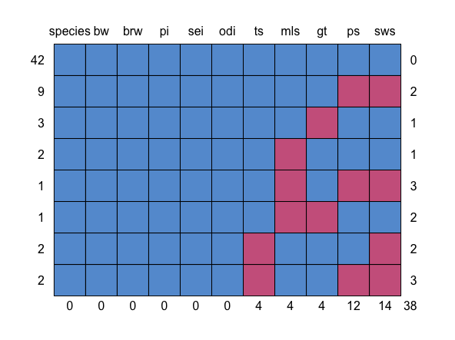
md.pattern(mammalsleep)
Variable names
Number of observations with the given combination of complete variables
Number of variables with missing values in the given combination of complete variables
Total number of missing values in variable

Slide 28
md.pattern()
Observations
42 observations are missing no data from any variables (~68%)
Six variables (species, bw, brw, pi, sei, odi) are missing no observations
sws is missing the most number of observations (14), ps is missing the second most (12), etc.

Slide 29
mice(): Arguments
The mice() function generates imputed data sets.
Arguments:
data | Data frame with missing values coded as NA
m | Number of imputations. Default is 5.
method | Imputation method. Either a single string or character vector indicating the method to be used for each column.
ignore | Logical vector (length nrow(data)) indicating rows to be ignored when creating imputation model
seed | Input for set.seed() to initiate random generator for imputation model

Slide 30
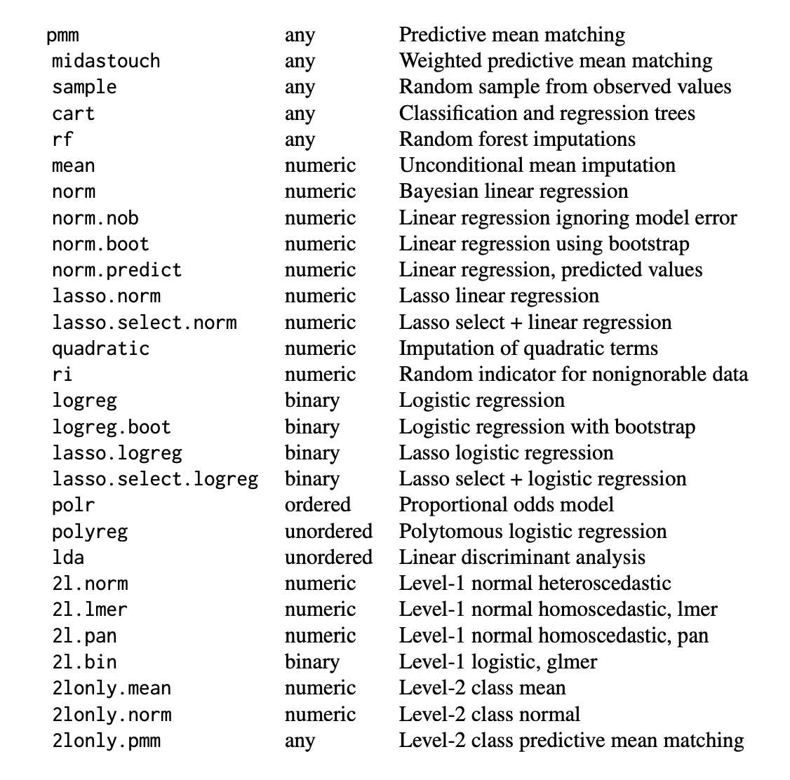
mice(): Imputation Methods
Depending on your variables of interest, different imputation methods will be applicable

Slide 31
mice(): Output
mice() outputs an object of type “mids” (multiply imputed data set) with the following attributes of note:
data – the original data set, with missing values
imp – a list of the imputed values for each variable. Values can be accessed through imp$VARIABLE.
A “mids” object also stores the inputs to mice() as attributes, such as method, ignore, seed, etc.

Slide 32
Estimation – with()
Executes an expression on several imputed data sets.
Syntax
with(data, expression)
data – object of type “mids”, outputed from mice()
expression – expression to evaluate for each imputed data set
with() outputs an object of type “mira” (multiply imputed repeated analyses) which displays the result of expression for each imputed data set in data.

Slide 33
Estimation – pool()
Averages the estimates computed across different data sets and computes variance due to multiple imputation.
Syntax
pool(object, dfcom = NULL, rule = NULL)
object – object of type “mira” from the with() function
dfcom and rule are not covered here but can be found in the function documentation.
pool()outputs an object of type “mipo” (multiply imputed pooled object) which summarizes the results of the pooled estimates.

Slide 34
Next
5.13 Reproducibility

